Slide 1
Open Science The Open Empirical Cycle
Section methodology and statistics/faculty social and behavioral sciences
Hanne Oberman
h.i.oberman@uu.nl
Based on presentations by Herbert Hoijtink, Bianca Kramer & Jeroen Bosman; re-use license: CC BY
Notes:
Update alle slides (circle appearance) a la the slides in de docenten versie – idem voor materialen beschikbaar stellen en ppt in de niet-filmpje versie

Slide 2
The Empirical Cycle
observation
evaluation
induction
testing
deduction
Notes:
The EC was developed by psychologist/chess player Adriaan de Groot, mid 20st century. Schematic overview of empirical, quantitative research. But not how science works nowadays.
Observation: The observation of a phenomenon and inquiry concerning its causes.
Induction: The formulation of hypotheses - generalized explanations for the phenomenon.
Deduction: The formulation of experiments that will test the hypotheses (i.e. confirm them if true, refute them if false).
Testing: The procedures by which the hypotheses are tested and data are collected.
Evaluation: The interpretation of the data and the formulation of a theory - an abductive argument that presents the results of the experiment as the most reasonable explanation for the phenomenon.
Source: Empirical research - Wikipedia
Image based on Empirical_Cycle.png: TesseUndDaanderivative work: Beao, CC BY 3.0 <https://creativecommons.org/licenses/by/3.0>, via Wikimedia Commons

Slide 3
The Empirical Cycle in Practice
observation
Step 1: Preparation
Step 2: Formulate research hypotheses
Step 3: Planning of data collection and analysis; write Data Management Plan
Step 4: Get approval from the (medical) ethical testing committee
Step 5: Pre-registration (or registered report)
Step 6: Execution of data collection and analyses
Step 7: Write report; publish pre-print
Step 8: Publish (meta-)data and analyses
Step 9: Having your report reviewed
Step 10: Publish open access
induction
deduction
testing
evaluation

Slide 4
The Open Empirical Cycle
funding & finding collaborators
preparation
including being
assessed/evaluated
assessment
discovery
search information &
getting access
incl. communication
with general public
analysis
data collection,
experimenting & analyzing
outreach
also including sharing
papers and data sets
publication
writing
including reference management & citing
Notes:
Simpel, kan nog simpeler, blijft model; werkelijk onderzoek nooit sequentieel

Slide 5
The Open Empirical Cycle
Rounds of grant writing
and application
preparation
Iterations of
search and reading
assessment
discovery
Tell story, get attention, be invited
analysis
Rounds of experiments and measurements
outreach
Submit, peer review, rejection, resubmitting
publication
writing
Drafting, receiving comments,rewriting
Notes:
Simpel, kan nog simpeler, blijft model; werkelijk onderzoek nooit sequentieel

Slide 6
Preparation:
Define & crowdsource research priorities
Organize project, team, collaborations
Get funding/contract
Assessment:
Comment/peer review
Determine impact of research output
Determine impact of researchers
preparation
Discovery:
Search literature/data/code/…
Get access
Get alerts/recommendations
Read/view
Annotate
assessment
discovery
Outreach:
Archive/share posters
Archive/share presentations
Tell about research outside academia
Researcher profiles/networks
Analysis:
Collect, mine, extract data/experiment
Share protocols/notebooks/workflows
Analyze
outreach
analysis
Publication:
Archive/share publications
Archive/share data & code
Select journal to submit to
Publish
Writing:
Write/code
Visualize
Cite
Translate
publication
writing
Notes:
Simpel, kan nog simpeler, blijft model; werkelijk onderzoek nooit sequentieel

Slide 8
Step 1: Preparation
Reviewing:
Review literature
Gaps in the literature
Quality of the literature
Variables that are not covered in the literature
Writing:
Writing it up sharpens thoughts
Write down you research questions:
New questions
Replication studies
Exploratory studies
observation

Slide 9
Step 2: Formulate Research Hypotheses
A research hypothesis is
a verbal representation
of the expected relations
between the variables
resulting from Step 1.
induction

Slide 10
Step 3: Planning of Data Collection and Analysis
Design:
Describe research design
Exploration?
Replication?
Data:
Describe population
Describe variables
Derived variables?
Analyses:
Statistical model
Formal hypotheses
Power analyses or updating
Missing data?
Data exclusion?
→ Data Management Plan
deduction

Slide 11
Step 4: (M)ETC
Much of the previous three steps
Data management plan (e.g., data storage)
Informed consent forms
Privacy regulations (e.g., GDPR)
deduction

Slide 12
Step 5: Pre-registration or Registered Report
This is the
pre-data-collection
or pre-data-access
account
of all that has been covered
in the previous four steps.
deduction

Slide 13
Step 6: Execution of Data Collection and Analysis
Proof that data collection
takes place after pre-registration.
Proof that data access
takes place after pre-registration.
testing

Slide 14
Step 7: Write Report
Write a reproducible report.
Include a link to your
pre-registration (Step 5).
Include a link to your
data-analyses repository (Step 8).
Publish pre-print.
evaluation

Slide 15
Step 8: Publish Data and Analyses
Data and analyses should be accessible to all interested parties, or FAIR:
Findable,
Accessible,
Interoperable,
Reusable.
evaluation
Notes:
Most of the remainder of this presentation
discusses how that can be achieved.

Slide 16
Step 9: Having your Report Reviewed
May lead to
changes in your report
and possibly
deviations from your pre-registration.
These deviations can be highlighted
in your report using footnotes.
evaluation

Slide 17
Step 10: Publish Open Access
Publishing open access is an important feature of open science.
Being able to unobstructedly obtain everything (also the report) related to a research project will enable anyone to:
benefit from your research
reuse (parts) of your research
engage in a fully informed discussion about your research.
This should both increase the impact of your research and increase the trust in your research and the trust in science in general.
evaluation

Slide 18
FAIR Data & Analyses
Findable: Place your data and analyses in a public repository
Accessible: Make certain your data come with a codebook, and your analyses with annotations
Interoperable: Ensure that data and analyses can be opened on different types of computers
Reusable: Include a license, that is, make clear what others are (not) allowed to do with your data
For further elaboration and information see “How to make your data FAIR” (Research Data Management Support, Utrecht University). To verify if your data is FAIR already, see FAIR Cheatsheets: to publish your research data and software FAIR - Research Data Management Support - Utrecht University (uu.nl).

Slide 19
Benefits of Open Data & Analyses
After publishing your data, analysis scripts, analysis results, and interpretation of the results, others can:
- Inspect your data
- Reproduce your analyses
- Read your interpretation of the analyses
- Data are available for meta-analyses and “null-findings” become accessible
Being open will add to the trust in your research, that of the group to which you belong, and science in general

Slide 20
The Conflict between Fully Open Data Analyses and Privacy Regulations
Personal data can only be published if privacy is guaranteed. One way to achieve this is, if data are truly anonymized (General Data Protection Regulation: https://gdpr-info.eu/).
Truly anonymized data is no longer personal data and thus no longer subject to the GDPR
It involves the complete and utter removal of all personal identifiers in a database
Anonymized data can no longer be attributed to any particular individual by any means
If anonymization cannot be achieved, you can still “Open your Analyses” by publishing only
your code book, results, references, license and annotated analyses (these are often called
meta data). This can be done using a myresults.html file that can be created based on your
mydata.jasp file.
This page was constructed using quotes and input from Handling Personal Data in Research (Utrecht University)

Slide 21
The Conflict between Fully Open Data Analyses and your Future Research Plans
Therefore, you may want to impose restrictions on the use of your data, e.g., “can only be used to reproduce the analyses you executed”
However, this cannot be arranged via the application of a license, data are often considered to be facts and facts cannot be copyrighted (OpenAIRE)
In such cases you can consider publishing only a part of your data, e.g., only the data and analyses that are used in a specific research report (but do provide complete meta data, most importantly, the code book of your complete data set)
Then the unused data are only available for you and thereby you avoid being scooped out of your next paper
OpenAIRE: https://www.openaire.eu/how-do-i-license-my-research-data

Slide 22
Open Science
Open Science is more than having publications and data openly available …
Open Science implies openly creating, sharing and assessing research, wherever viable

Slide 23
Open Science is …
Open to participation
Open to (re)use
Open to the world
No barriers based on race, gender, income, status, language, ableness, age
Involvement of societal partners in research priority setting
Evaluations that include societal relevance
Citizen science & co-creation
Broadly considering all knowledge (including local knowledge)
Error friendly environment
Open Access, f. people/machines, to:
Proposals and applications
Preregistrations
Data
Code
Preprints, working papers
Papers and books
Reviews and comments
Posters and presentations
Open, non-proprietary standards
Open licences
Full documentation of process, including negative results
Translations
Plain language explanations
Outreach beyond academia
Open to questions from outside academia
Curation and annotation of non-scholarly information
Participation in public debate
and: Open educational resources / Open source software / Open hardware / (no) patents
From: Bosman & Kramer (2017) Defining open science definitions

Slide 24
Open Science basic mindset
create
create
reuse / modify
share
share
reuse / modify
use
use

Slide 25
Why Open Science?
Transparency, accountability
Efficiency
Reproducibility & verifiability
Relevance & stakeholder involvement
Notes:
There are many aspects of open science……

Slide 26


Links to …
JASP
A Crash Course into JASP
How to use JASP
REPOSITORIES
Open Science Foundation
Yoda (Utrecht University)
LICENCES
Creative Commons
OpenAIRE
ANONIMIZED AND FAIR DATA
How to Make you Data FAIR
Handling Personal Data
FAIR Cheatsheets
General Data Protection Regulation
OPEN SCIENCE
Open Science Community Utrecht
Summer school ‘Open Science Bootcamp’

Slide 27
Links to …
THE WORKSHOP MATERIALS
Open your Course/Bachelor Thesis

Slide 28
How To …
Use one of the example data sets that downloaded with this presentation: data.sav, data.txt, or data.csv.
Execute each of the steps in the following slides.

Slide 29
How to Create a mydata.jasp File
Make certain that JASP is installed on your computer. If not, install it from https://jasp-stats.org/download/
If JASP is installed, start the program.

Slide 30
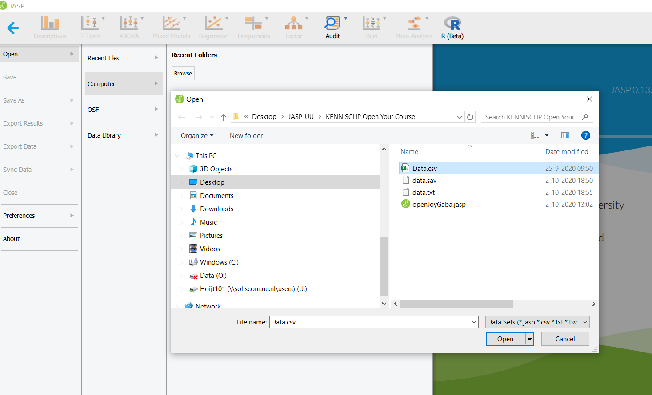
Open a .csv, .sav, or .txt file containing your data
1
2
3
4
5
6

Slide 31
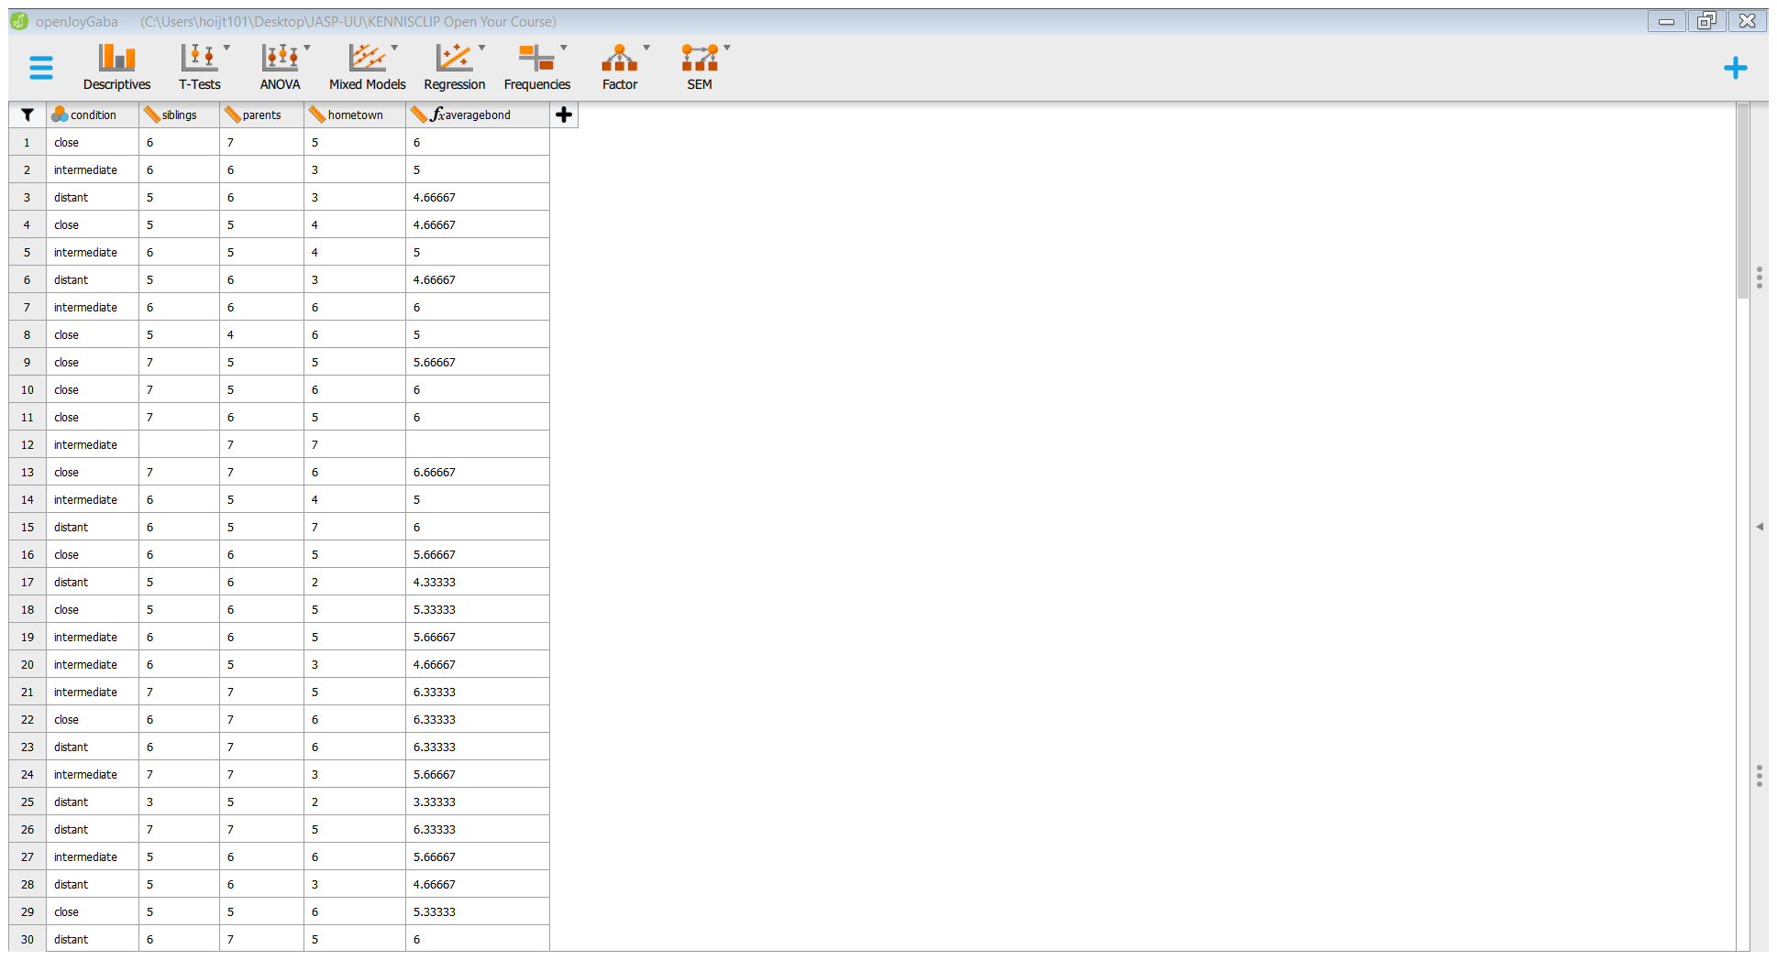
After the data spreadsheet opens
Click on Descriptives to open the analysis screen

Slide 32
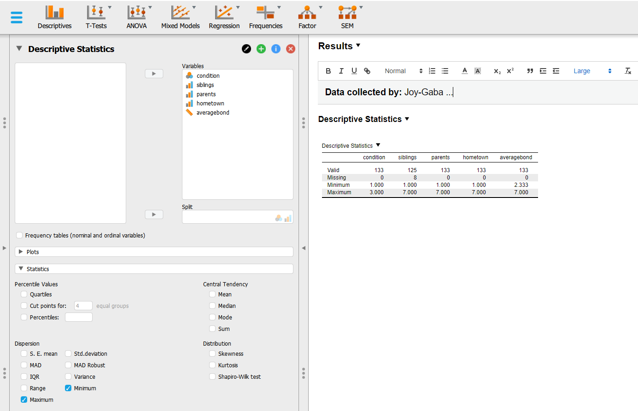
Execute your Analyses – Start with Simple Descriptives – and Add Notes to your Results
1
4. Click the black triangle and choose annotate
5. Use the lay-out options such as bold face, font size, etc.
2
3
Notes:
Laat de cirkels één voor één verschijnen

Slide 33
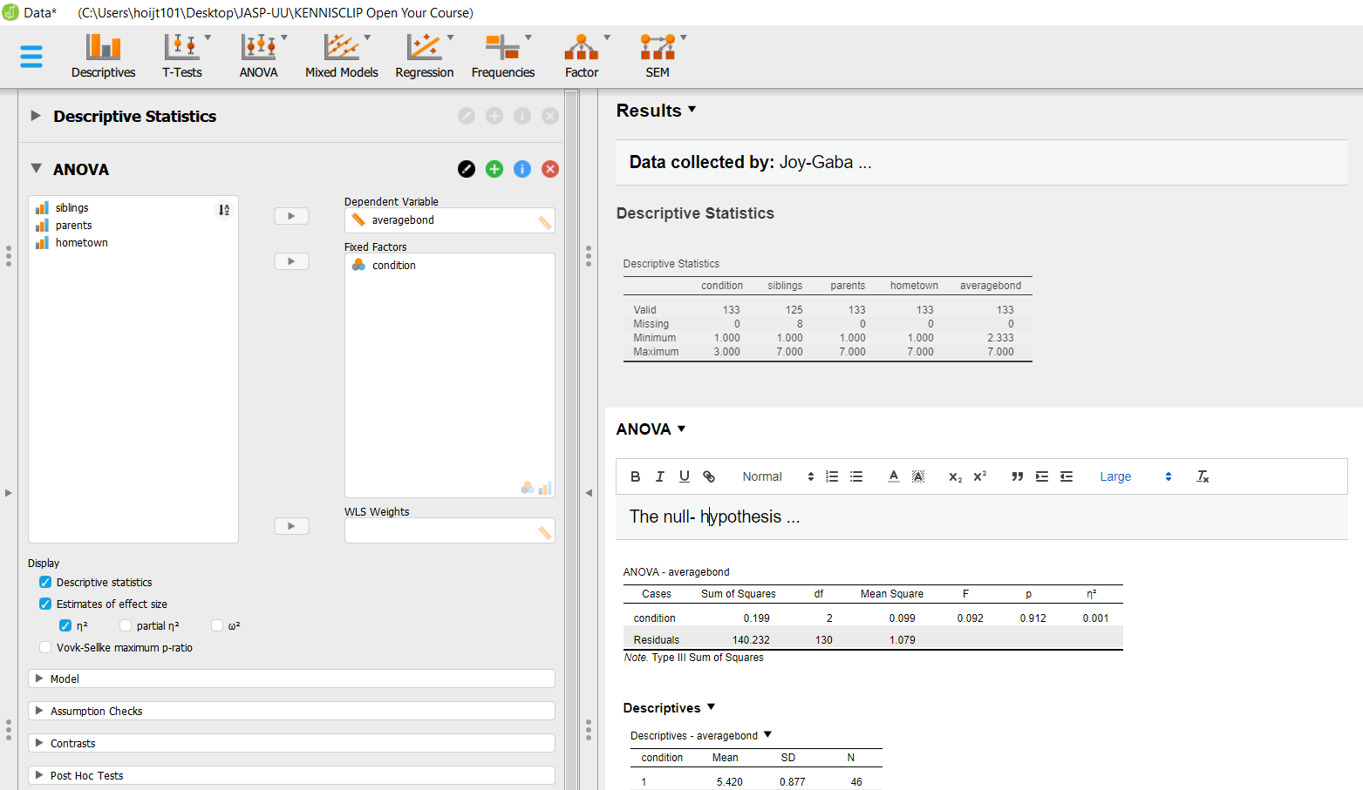
Continue your Analyses with an ANOVA and Add Notes to your Results
1
2
4: click the black triangle and choose annotate
5
3
Notes:
Laat de cirkels één voor één verschjijnen

Slide 34
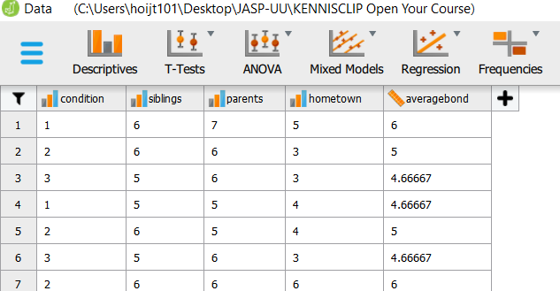
Please note that …
Currently you have to make a different mydata.jasp file for each selection of cases you make, e.g., before filtering
(marked by the red ellipse), and before deleting or adding cases. Otherwise, all your analyses will be based on the
latest selection of cases created.
This will be remedied in one of the future JASP releases.
A knowledge clip explaining the main features of JASP (selecting cases, computing variables, recoding, opening
a data file, saving a mydata.jasp file, executing analyses, getting help, etc.) can be found at https://osf.io/z7tbg/
A virtually complete elaboration of all the features of JASP can be found at https://jasp-stats.org/how-to-use-jasp/
Notes:
De crash course is er nog niet!

Slide 35
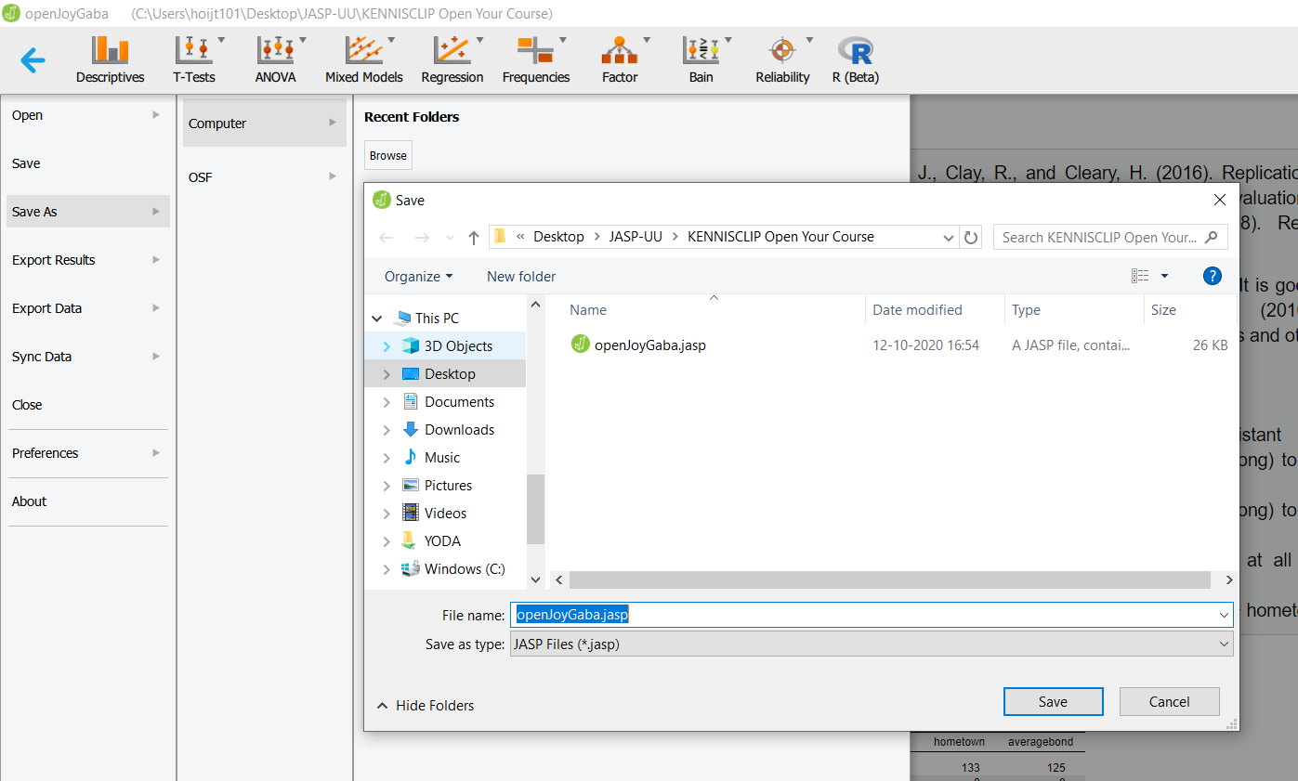
Save as a mydata.jasp File on your Computer – contains data, analyses input and annotated analyses results
2
3
1
4
5
6

Slide 36
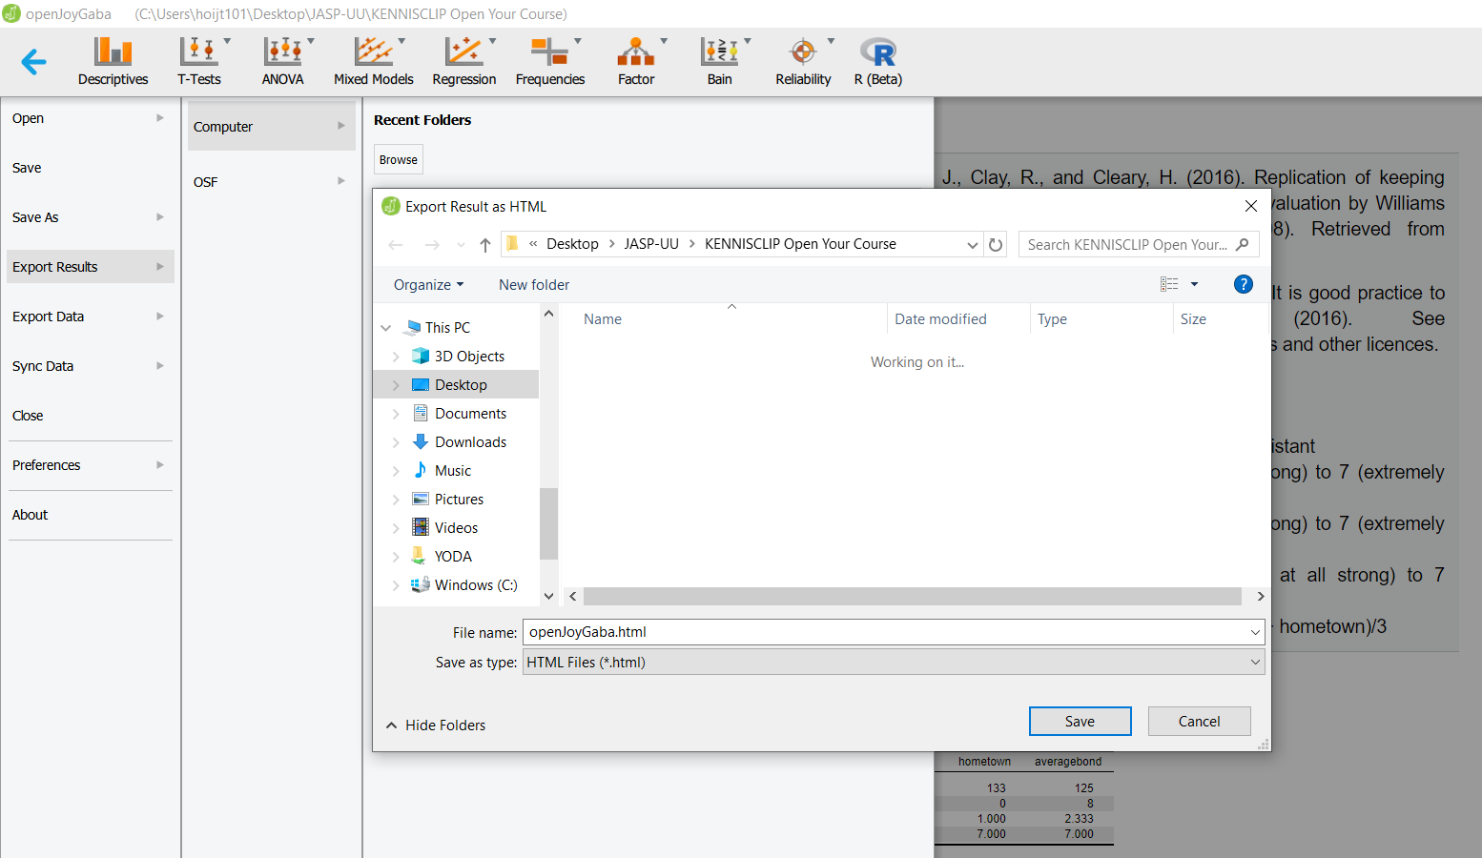
Save a mydata.jasp file as a myresults.html File on your Computer – only contains the annotated results
2
3
4
1
5
6
Notes:
Laat de cirkels één voor één verschijnen

Slide 37
How to Make your Data Analyses Findable Using the Open Science Foundation

Slide 38
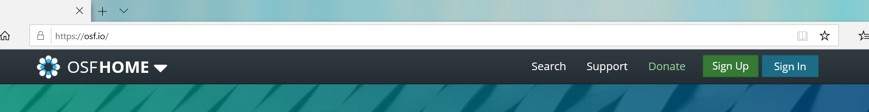
Create a Project to Store your Data at the Open Science Foundation in Four Simple Steps
1
2

Slide 39
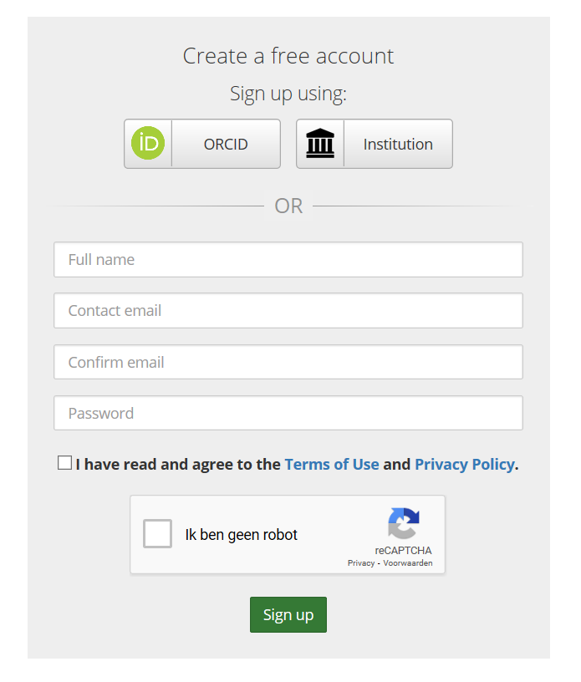
Step 1: Create a Free Account
1
2
3
4

Slide 40
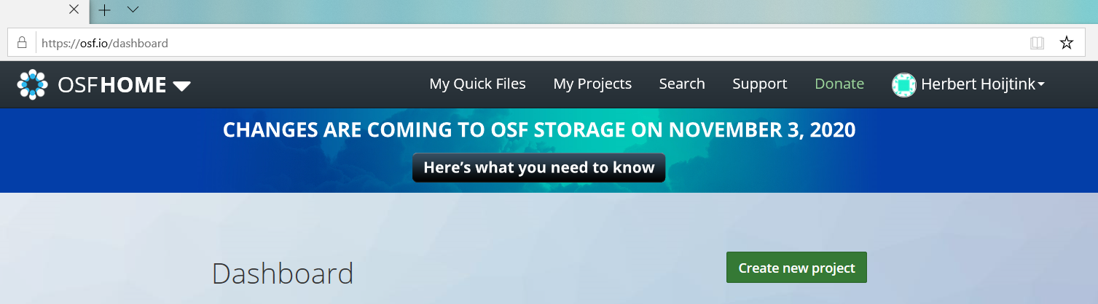
Step 2: Create a New Project

Slide 41
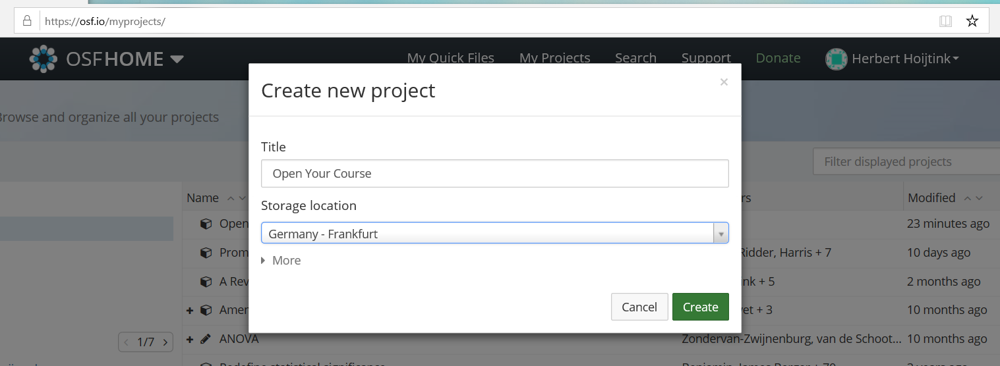
Step 2: Create a New Project (continued)
1
2
3

Slide 42
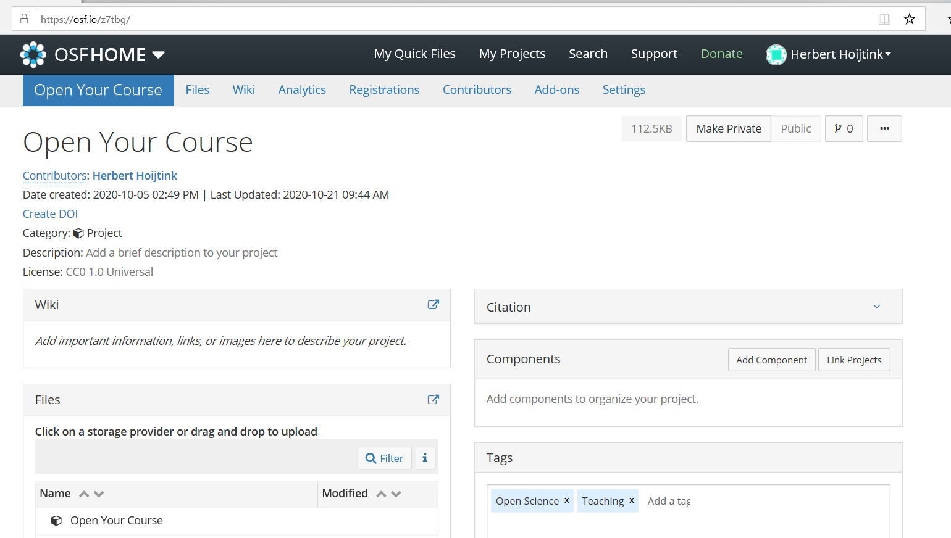
Step 3: Make your Project Publicly Available
1: anybody can surf here to access your data analyses if …
2: … you make your project publicly available
3
4
Notes:
Laat de cirkels één voor één verschijnen

Slide 43
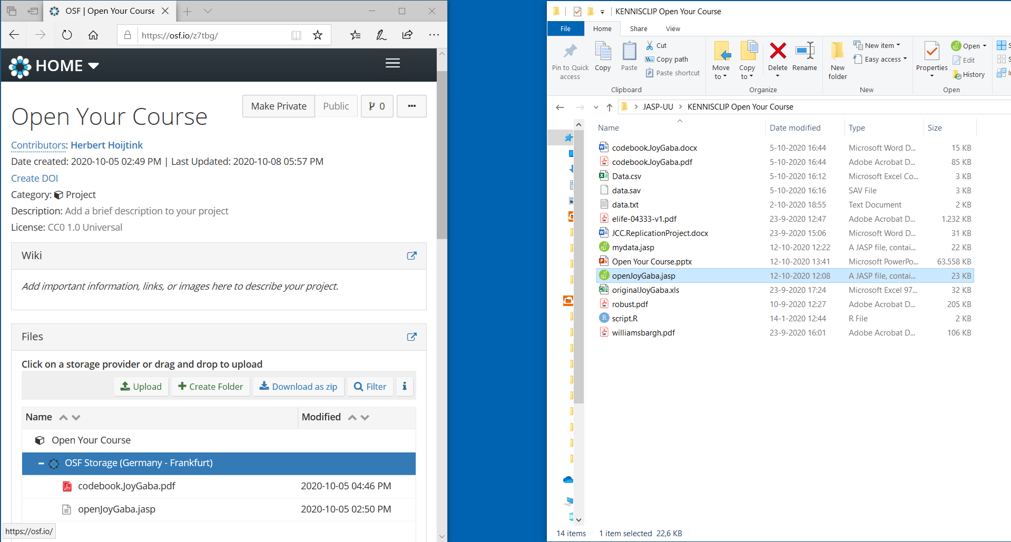
Drag your Data and other Relevant Files into the Project you Created
Drag files onto the blue bar
to add them to your project
Notes:
Pick up all my stuff from osf to try yourself.

Slide 44
The End

Slide 45
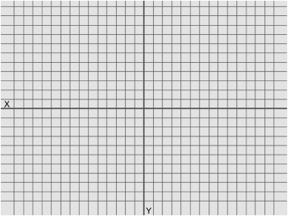
An Experiment and its Replication
An experiment with three conditions:
Participants Rated:
The “close” condition
Attachment to
Siblings
Parents
Home-town
The “intermediate” condition
The “distant” condition
on a
1 (not at all strong) – 7 (extremely strong)
Likert scale
which are averaged to obtain
the dependent variable
attachment
The description given here is a modification of and inspired by the actual experiment executed by
Williams, L.E. and Bargh, J.A. (2008). Keeping One’s Distance. The Influence of Spatial Distance Cues on Affect and Evaluation. Psychological Science, 19, 302-308.

Slide 46
Williams and Bargh (2008) tested:
The replication by Joy-Gaba, Clay, and Cleary (2016) rendered
H₀: µ_{close}= µ_{intermediate} = µ_{distant} ,
that is, the three means are equal
rendering
p-value = .01, that is, smaller than .05,
that is, the means are significantly different
with
m_{close} = 5.61 , m_{intermediate} = , m_{distant} = 4.86
and
η² = .11 ,
that is, the three conditions explain
11% of the variation in attachment,
which is a medium to strong effect of condition
p-value = .79
η² = .00
Joy-Gaba, J., Clay, R., and Cleary, H. (2016). Replication of keeping one’s
distance: The influence of spatial distance cues on affect and evaluation by
Williams L.E. and Bargh J.A. (2008) Psychological Science, 19, 302-308).
Retrieved from https://osf.io/a78bm/

Slide 47
The Replication Crisis
This is only one of 100 psychological experiments of which only about 33% were successfully replicated (OSC, 2015).
This resulted in a reduced trust in science by scientists and society: The replication crisis was born.
Scientists are alerted:
“Society” is alerted:
Estimating the reproducibility of psychological science (OSC, 2015)
An open investigation of the reproducibility of cancer biology research (Errington et al., 2014)
Is psychology a real science? (Is psychologie wel een echte wetenschap, Volkskrant, 12-8-2016)
Public Trust in Science (Rathenau Instituut, August 28, 2018)
Open Science Collaboration. (2015). Estimating the reproducibility of psychological science. Science, 349, 6251. https://osf.io/ezcuj/
Errington, T.M., Iorns, E., Gunn, W., Tan, F.E., Lomax, J., and Nosek, B.A. (2014). An open investigation of the reproducibilty of cancer biology research. eLIFE, 3, e04333. https://elifesciences.org/collections/9b1e83d1/reproducibility-project-cancer-biology
Volkskrant (2016). https://www.volkskrant.nl/columns-opinie/is-psychologie-wel-een-echte-wetenschap~b9978e6c
Rathenau Instituut (2018). Public Trust in Science. https://www.rathenau.nl/en/science-figures/impact/trust-science/public-trust-science

Slide 48
Open the Data Analyses of your Thesis
… can easily be done using:
… applies to:
All research based on quantitative data

Slide 49
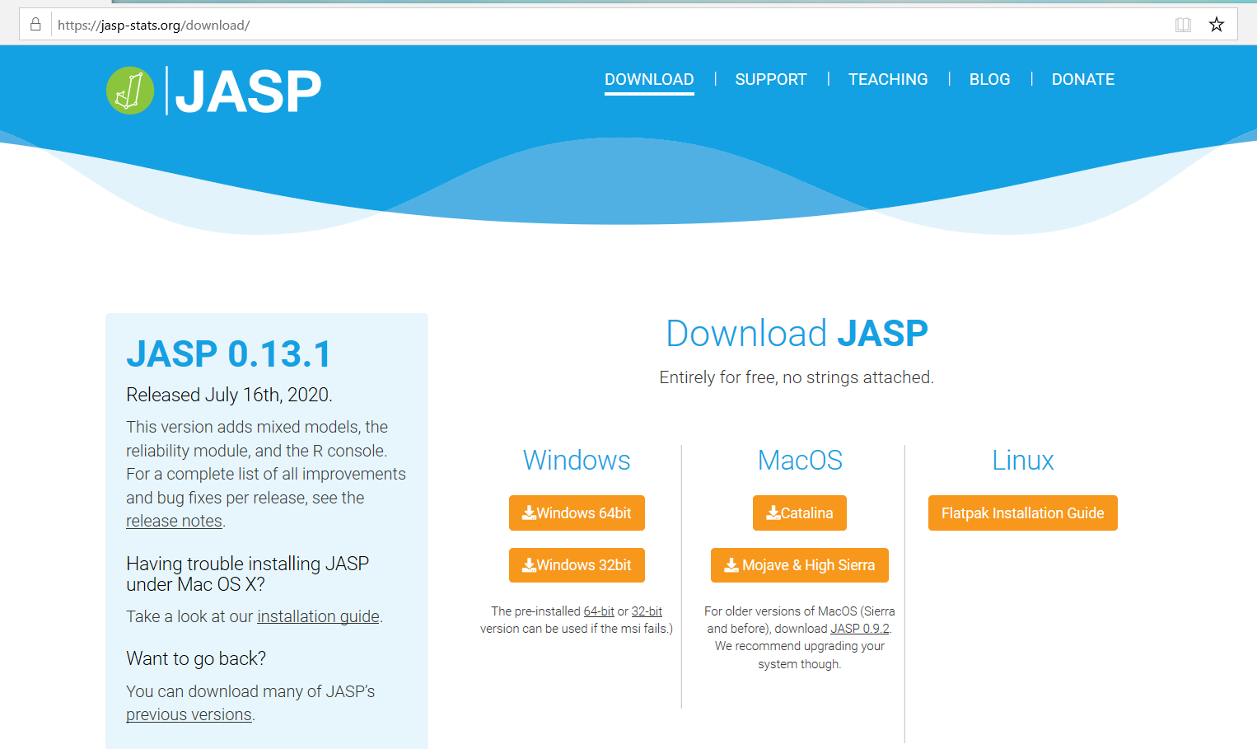
Interoperable
A Crash Course into JASP
How to use JASP

Slide 50
Accessible
Joy-Gaba, Clay, and Cleary (2016) replicated Willams and Bargh (2008)
The replication data and analyses are contained in openJoyGaba.jasp

Slide 51
The Data Collected by Joy-Gaba, Clay, and Cleary (2016)

Slide 52
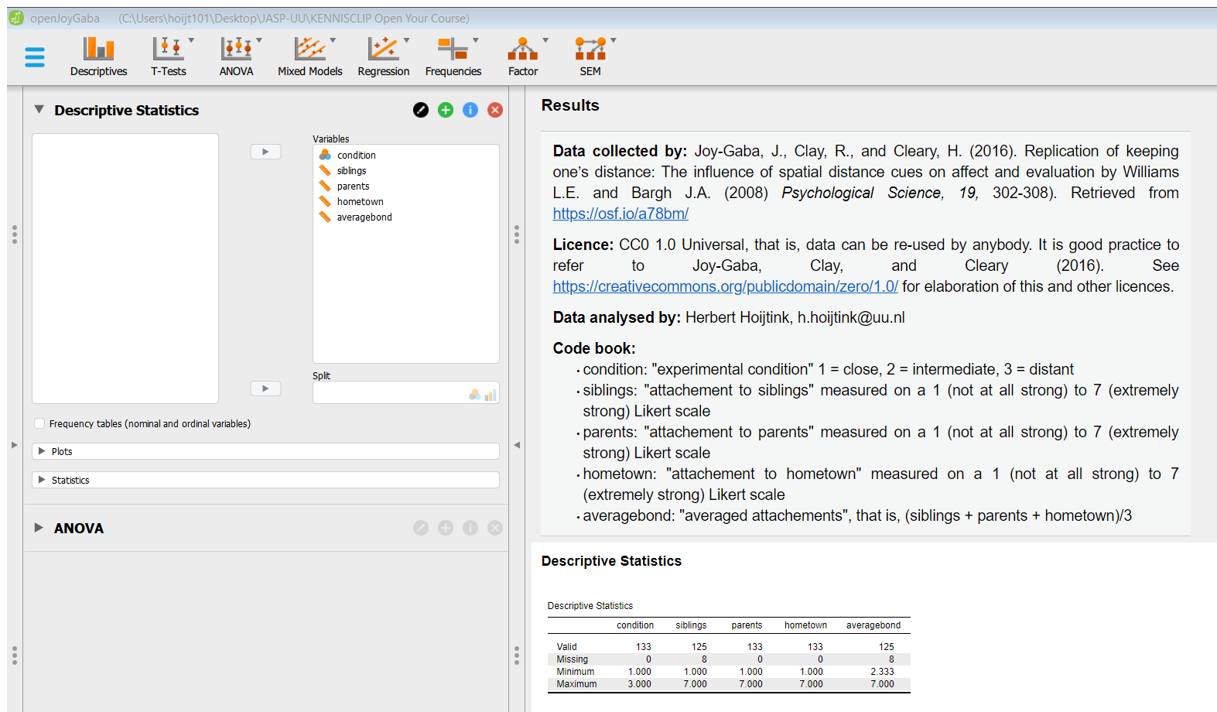
Data collected by, License, Data analyzed by, Code book, and Descriptive Statistics

Slide 53
Include Annotations of your Analyses
Explain using annotations which analyses were executed and what your interpretation of the outcomes was

Slide 54
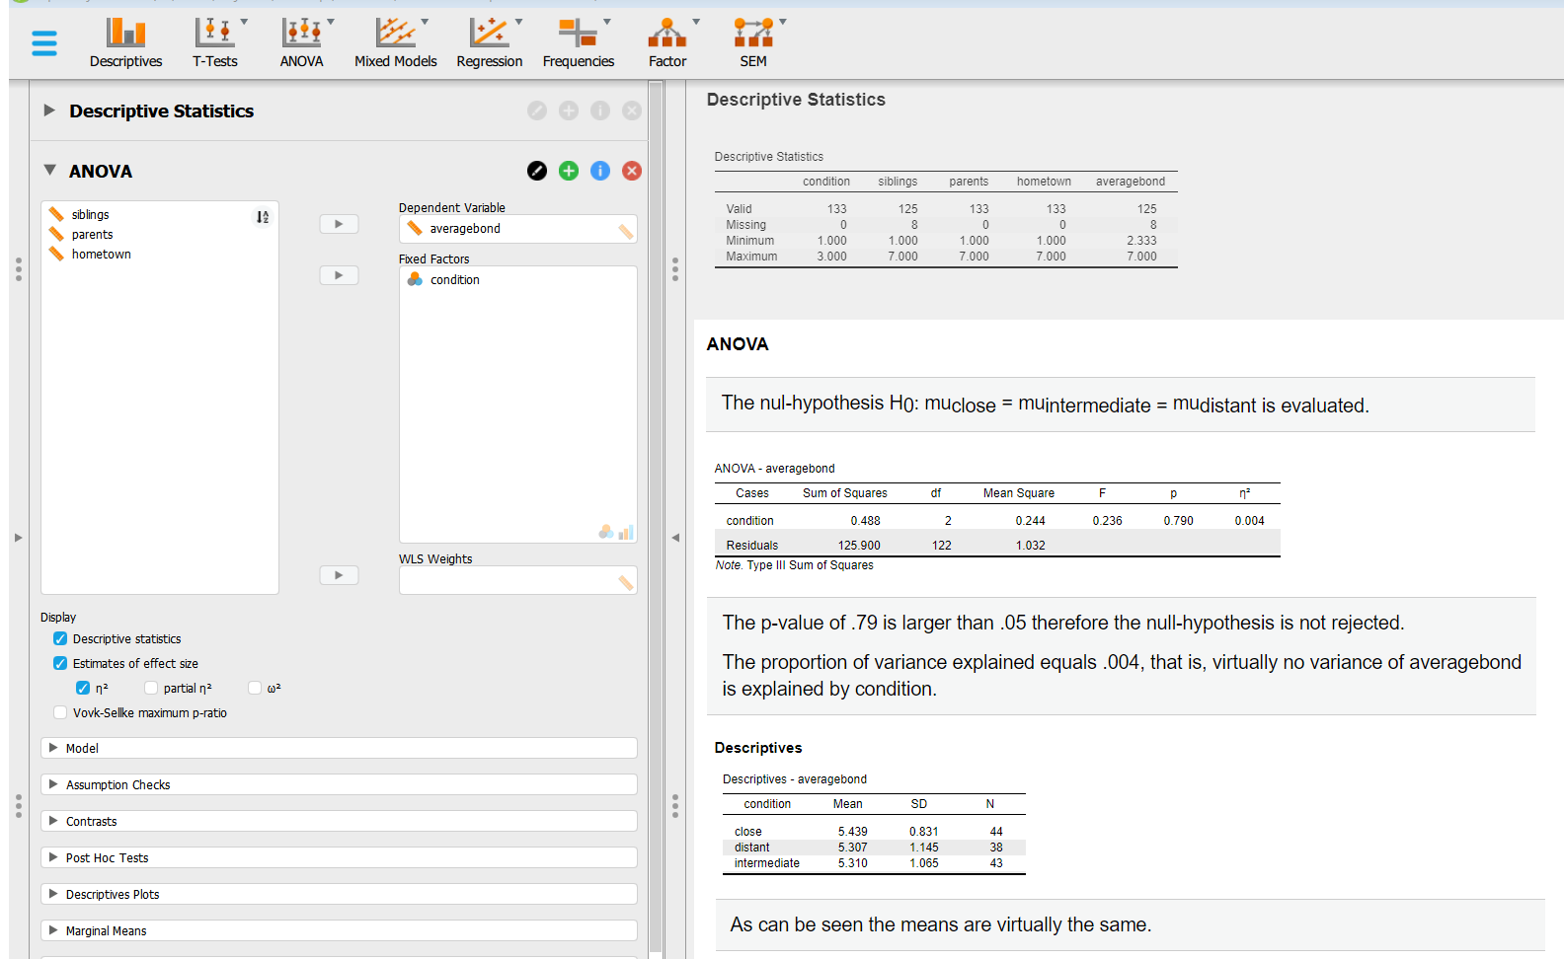
Annotated Analyses

Slide 55
By doing this you Create an Annotated Logbook of your Analyses
As shown on the previous two slides JASP tracks the analyses that you execute
There is a Descriptive Statistics button on the left side of the screen
rendering the data overview on the right side of the screen
There is an ANOVA button on the left side of the screen
rendering analyses with annotations on the right side of the screen
If you continue executing analyses and adding annotations to your analyses, you create a logbook that will
help you to track your traces, therefor it will be completely clear to others:
Which analyses you did
How you did them (this should shortly be explained in the annotations)
How you interpret the results (this should shortly be explained in the annotations)
In this manner you make the data and analyses from your study accessible
Notes:
It is important to highlight that if you continue to add analyses, you create an annotated logbook of all the analyses you did. There are now Descriptive and ANOVA buttons in your JASP file, but you could continue and add other buttons. This will enable anybody opening your JASP file to see: which analyses you did, how you did them, and how interpreted the results. In this manner you adhere to the A in FAIR, and make your data and analyses ACCESIBLE.

Slide 56
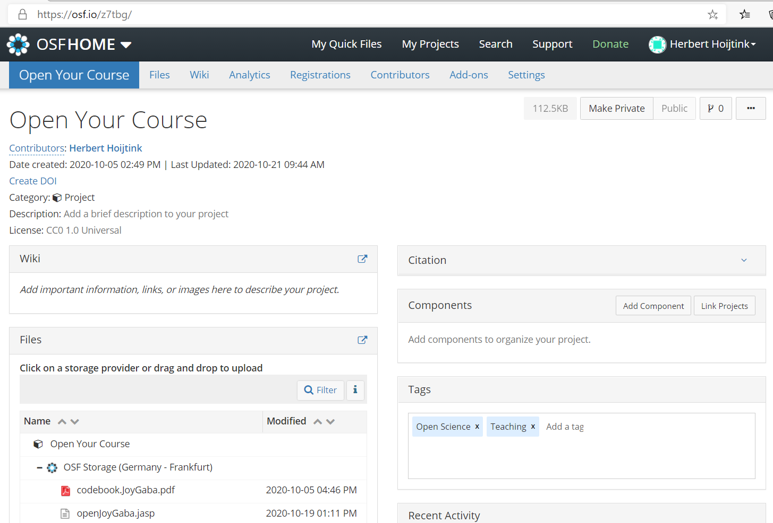
Findable Using the Open Science Foundation

Slide 57
Reusable
Fully Open Data Analyses: Include the CC0 1.0 Universal License With Your Data
The license can be included in your mydata.jasp file.
The CC0 1.0 Universal Public Domain Dedication:
Is truly open, that is, anybody can use your data for whatever purpose
If you include a reference to a paper or your contact information in the mydata.jasp file, anybody using your data can refer to you
The CC0 1.0 Universal Public Domain Dedication: https://creativecommons.org/publicdomain/zero/1.0/

Slide 58
The Conflict between Fully Open Data Analyses and Privacy Regulations
Personal data can only be published if privacy is guaranteed. One way to achieve this is, if data are truly anonymized (General Data Protection Regulation: https://gdpr-info.eu/).
Truly anonymized data is no longer personal data and thus no longer subject to the GDPR
It involves the complete and utter removal of all personal identifiers in a database
Anonymized data can no longer be attributed to any particular individual by any means
If anonymization cannot be achieved, you can still “Open your Analyses” by publishing only
your code book, results, references, license and annotated analyses (these are often called
meta data). This can be done using a myresults.html file that can be created based on your
mydata.jasp file.
This page was constructed using quotes and input from Handling Personal Data in Research (Utrecht University)

Slide 59
The Conflict between Fully Open Data Analyses and your Future Research Plans
Therefore, you may want to impose restrictions on the use of your data, e.g., “can only be used to reproduce the analyses you executed”
However, this cannot be arranged via the application of a license, data are often considered to be facts and facts cannot be copyrighted (OpenAIRE)
In such cases you can consider publishing only a part of your data, e.g., only the data and analyses that are used in a specific research report (but do provide complete meta data, most importantly, the code book of your complete data set)
Then the unused data are only available for you and thereby you avoid being scooped out of your next paper
OpenAIRE: https://www.openaire.eu/how-do-i-license-my-research-data

